Slide 1
Chapter Two Problem Solving Paradigms
Complete Search
Divide and Conquer
Greedy
Dynamic Programming

Slide 2
Compete Search(aka Brute Force)
The Complete Search technique, also known as brute force or recursive backtracking, is a method for solving a problem by traversing the entire (or part of the) search space to obtain the required solution. During the search, we are allowed to prune (that is, choose not to explore) parts of the search space if we have determined that these parts have no possibility of containing the required solution.
In programming contests, a contestant should develop a Complete Search solution when there is clearly no other algorithm available (e.g. the task of enumerating all permutations of {0, 1, 2, . . . , N - 1} clearly requires O(N!) operations)

Slide 3
Complete search
In ICPC, Complete Search should be the first solution considered as it is usually easy to come up with such a solution and to code/debug it. Remember the ‘KISS’ principle: Keep It Short and Simple. A bug-free Complete Search solution should never receive the Wrong Answer (WA) response in programming contests as it explores the entire search space.
Types
Iterative complete Search
Recursive complete Search

Slide 4
1.Iterative complete Search
Problems that could be solved using loops (while or for loops).
Loops could be nested(single, double, triple ….loops).
Time complexity of iteration can be found by finding the number of cycles being repeated inside the loop.

Slide 5
2.Recursive complete Search
The process in which a function calls itself directly or indirectly is called recursion and the corresponding function is called as recursive function. Using recursive algorithm, certain problems can be solved quite easily.
The idea is to represent a problem in terms of one or more smaller problems, and add one or more base conditions that stop the recursion. For example, we compute factorial n if we know factorial of (n-1). The base case for factorial would be n = 0. We return 1 when n = 0.
If the base case is not reached or not defined, then the stack overflow problem may arise.

Slide 6
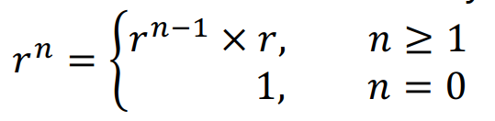
Calculating 𝑟^{n} mod 𝑚
Let’s define a function that calculates 𝑟" mod 𝑚: int mypower(int r, int n, int m);
Precondition: 𝑟 ≠ 0, 𝑛 > 0 and 𝑚 > 0 (to avoid situations like 0⁰)
𝑟^{n} can be defined recursively:
We can code exactly this idea, which is 𝑂 𝑛 .

Slide 7

Calculating 𝑟^{n} mod 𝑚
We can improve the time complexity into 𝑂 log 𝑛 by defining 𝑟^{n} in another way (but also recursively)
From the Exponential Law: (𝑟ª)^{b} = r^{ab} .
By squaring, we can decrease 𝒏 into half. • If 𝑛 is even, we can apply this formula directly. • If 𝑛 is odd, 𝑛 - 1 is even, so we can calculate 𝑟^{n-1} by the formula and then multiply 𝑟.

Slide 8
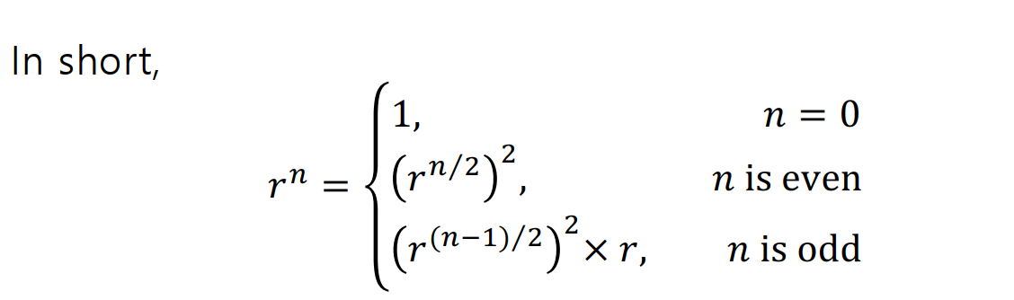
Calculating 𝑟^{n} mod 𝑚
If we compute 𝑟^{n} mod 𝑚 like this, time complexity is 𝑂(log 𝑛)
since we call the function such that 𝑛 is at most its half

Slide 9
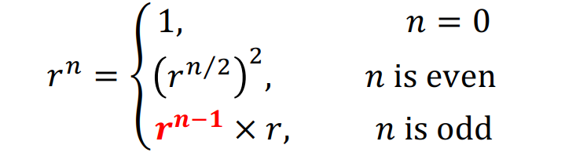
Calculating 𝑟^{n} mod 𝑚
Simplified version.

Slide 10
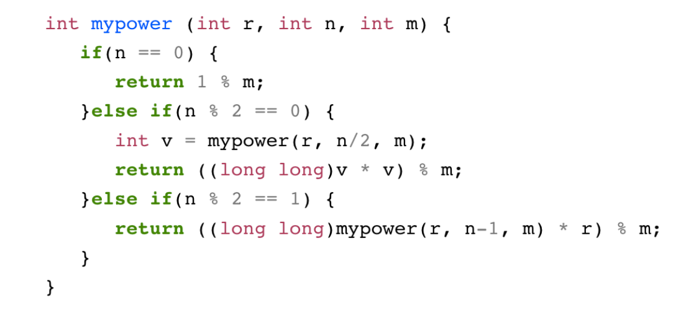
Calculating 𝑟^{n} mod 𝑚
Now, the code becomes like:

Slide 11
Examples
Abridged problem statement: Given three integers A, B, and C (1 ≤ A, B, C ≤ 10000), find three other distinct integers x, y, and z such that x + y + z = A, x × y × z = B, and x² + y² + z² = C.
We could just iterate through -10000 to 10000 for each x, y and z using 3 loops until all the conditions are satisfied.
But we could use the third equation(x² + y² + z² = C) to narrow our search down
Assuming that C has the largest value of 10000 and y and z are one and two (x, y, z have to be distinct), then the possible range of values for x is [-100 . . . 100]. We can use the same reasoning to get a similar range for y and z. We can then write the following triply-nested iterative solution below that requires 201 × 201 × 201 ≈ 8M operations per test case.

Slide 12
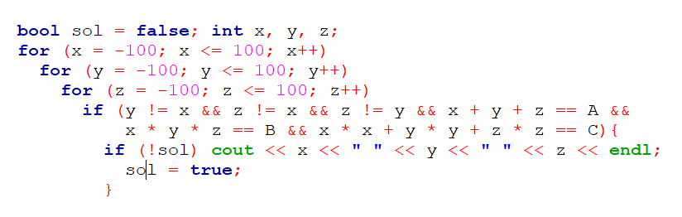
Solution 1

Slide 13
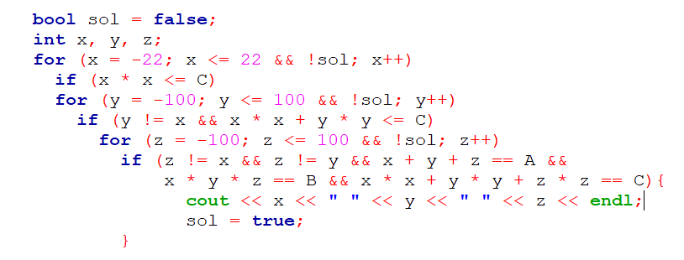
Solution 2
We can also use the second equation x × y × z = B and assume that x = y = z to obtain x × x × x < B or x < √3 B. The new range of x is [-22 . . . 22].

Slide 14
Complete Search
Divide and Conquer
Greedy
Dynamic Programming

Slide 15
Divide and Conquer
Divide and Conquer (abbreviated as D&C) is a problem-solving paradigm in which a problem is made simpler by ‘dividing’ it into smaller parts and then conquering each part. The steps: 1. Divide the original problem into sub-problems—usually by half or nearly half, 2. Find (sub)-solutions for each of these sub-problems—which are now easier, 3. If needed, combine the sub-solutions to get a complete solution for the main problem.
Generally reduces to O(n log(n)) to O(log(n)).
Some interesting algorithms
Binary search
Merge sort
Closest pair of points

Slide 16
Binary Search
Binary search is a fast search algorithm with run-time complexity of Ο(log n). This search algorithm works on the principle of divide and conquer. For this algorithm to work properly, the data collection should be in the sorted form.
Binary search looks for a particular item by comparing the middle most item of the collection. If a match occurs, then the index of item is returned.
If the middle item is greater than the item, then the item is searched in the sub-array to the left of the middle item. Otherwise, the item is searched for in the sub-array to the right of the middle item. This process continues on the sub-array as well until the size of the subarray reduces to zero.
Time complexity O(log(n)).

Slide 17

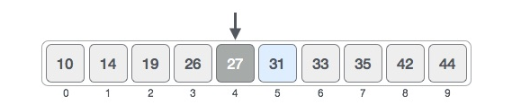

Binary Search
Binary search works only on monotonic functions( increasing or decreasing functions).
The following is our sorted array and let us assume that we need to search the location of value 31 using binary search.

Slide 18
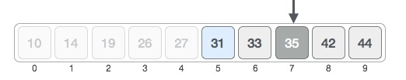
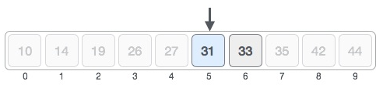

Binary Search

Slide 19
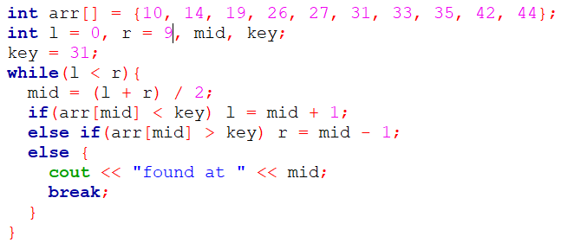
Binary Search

Slide 20
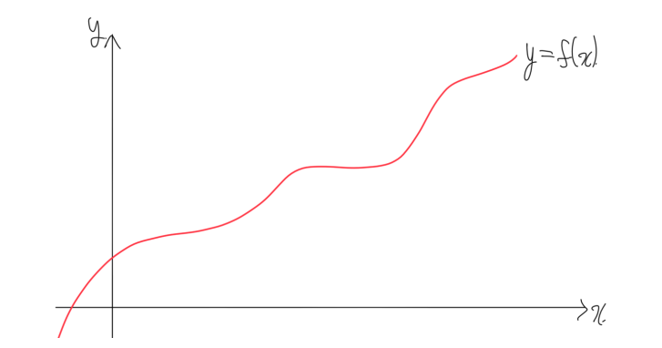
Binary search on functions
To apply binary search on arrays, the array should be monotonically increasing.
Like that, we can also apply a binary search on a monotonically increasing function 𝑓: ℝ → ℝ. Assume it is continuous.

Slide 21
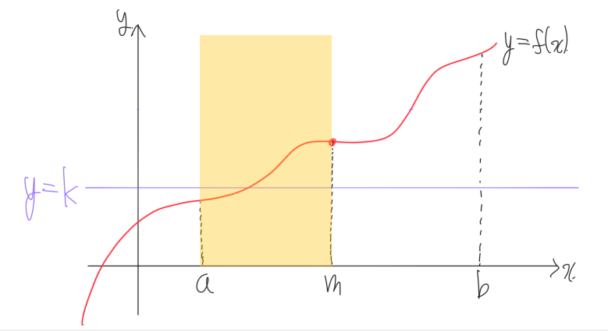
Binary Search on function
Find the midpoint 𝑚 = (a + b) / 2 and calculate 𝑓(𝑚).
If 𝑓(𝑚) > 𝑘, 𝑓 ( 𝑚 … b) > 𝑘 also holds. Therefore we can shrink the interval to [a, 𝑚] .

Slide 22
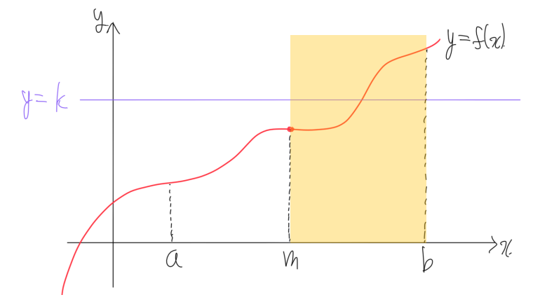
Binary Search on function
Find the midpoint 𝑚 = (a + b) / 2 and calculate 𝑓(𝑚).
If 𝑓(𝑚) < 𝑘, 𝑓 (𝑎... 𝑚) < 𝑘 also holds. Therefore we can shrink the interval to [𝑚, 𝑏] .

Slide 23
Binary Search on function
So, we can start from the interval 𝑙, 𝑟 and repeat these steps: • Set the midpoint 𝑚 = (l + r) / 2. • If 𝑓 𝑚 > 𝑘, shrink the interval to [𝑙, 𝑚]. • If 𝑓 𝑚 < 𝑘, shrink the interval to [𝑚, 𝑟].
If we repeat these steps 𝑠 times, the length of the interval will become (l + r) / 2^{s}.
You should fix an appropriate 𝑠, by comparing the desired precision that we want .

Slide 24
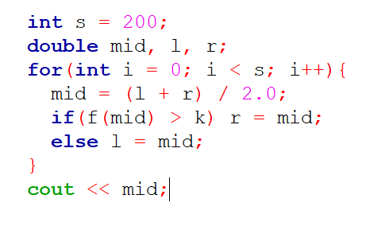
Binary Search on function

Slide 25
Some problems can be solved by binarysearch on functions
Example problem: You are given 𝑛 sticks. Each stick has length 𝑎₁, 𝑎₂, ⋯ , 𝑎_{n}.
We are going to make at least 𝑘 sticks with the same length, by cutting the given sticks.
We are not allowed to glue sticks, so we may have to throw away some sticks (if the length is not the same)
What is the maximum possible length the resulting sticks?

Slide 26
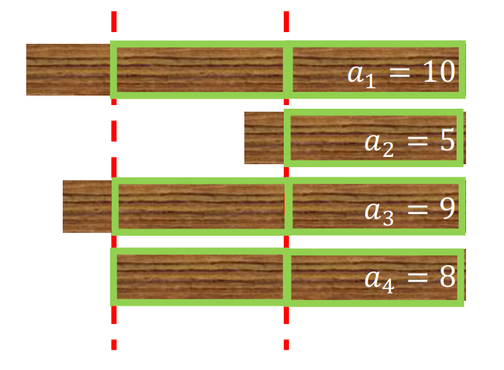
Some problems can be solved by binarysearch on functions
Example for the example problem:
If 𝑘 = 7, we can cut the sticks into length 4. Then, exactly 7 sticks are available, and it is the maximum possible length.

Slide 27
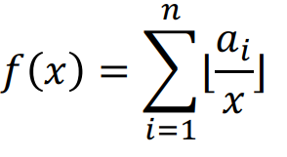

Some problems can be solved by binarysearch on functions
Solution: Suppose we fixed the length by 𝑥.
Then, we can easily calculate the number of usable sticks by:
And 𝑓 (𝑥) is monotonically decreasing, since
is a monotonically decreasing function, so sum is monotonically decreasing too. • It is obvious that if we increase the length, the number of usable sticks will decrease.

Slide 28
Bisection Method
Objective is to find a solution of F(x) = 0 Where F is a polynomial or a transcendental function, given explicitly.
Exact solutions are not possible for most equations.
A number x ± e, ( e > 0 ) is an approximate solution of the equation if there is a solution in the interval [x-e, x+e]. e is the maximum possible error in the approximate solution.
With unlimited resources, it is possible to find an approximate solution with arbitrarily small e.

Slide 29
Bisection Method
Let F(x) be a continuous function and let a and b be real numbers such that f(a) and f(b) have opposite signs.
Then there is a x* in interval [a,b] such that F(x*) = 0.
Then c = (a + b)/2 is an approximate solution with maximum possible error (b – a)/2.
If f(c) and f(a) have opposite signs then the solution x* is in the interval [a,c]. Then, again, d = (c + a)/2 is an approximate solution but with max possible error (b – a)/4.
Else the solution is in the interval [c,b]. The approximate solution now is (c+b)/2 with max possible error (b-a)/4.
Continuing this process n times we can reduce the max possible error to (b-a)/2^{n}.

Slide 30
Complete Search
Divide and Conquer
Greedy
Dynamic Programming

Slide 31
Greedy
An algorithm is said to be greedy if it makes the locally optimal choice at each step with the hope of eventually reaching the globally optimal solution. In some cases, greedy works—the solution is short and runs efficiently. 1. It has optimal sub-structures. Optimal solution to the problem contains optimal solutions to the sub-problems. 2. It has the greedy property (difficult to prove in time-critical contest environment!). If we make a choice that seems like the best at the moment and proceed to solve the remaining sub-problem, we reach the optimal solution. We will never have to reconsider our previous choices.

Slide 32
Example
Problem description: Given a target amount V cents and a list of denominations of n coins, i.e. we have coinValue[i] (in cents) for coin types i ∈ [0..n-1], what is the minimum number of coins that we must use to represent amount V ? Assume that we have an unlimited supply of coins of any type. Example: If n = 4, coinValue = {25, 10, 5, 1} cents, and we want to represent V = 42 cents, we can use this Greedy algorithm: Select the largest coin denomination which is not greater than the remaining amount,
i.e. 42-25 = 17 → 17-10= 7 → 7-5 = 2 → 2-1 = 1 → 1-1 = 0, a total of 5 coins. This is optimal.

Slide 33
Example
However, this greedy algorithm does not work for all sets of coin denominations. Take for example {4, 3, 1} cents. To make 6 cents with that set, a greedy algorithm would choose 3 coins {4, 1, 1} instead of the optimal solution that uses 2 coins {3, 3}

